Slide 1
Human Subjects Protection Program
Christine Melton-Lopez, MS, CIP
Director
Debbie Lewis, BS, BA
Assistant Director

Slide 2
2020 Non-Committee Workload

Slide 3
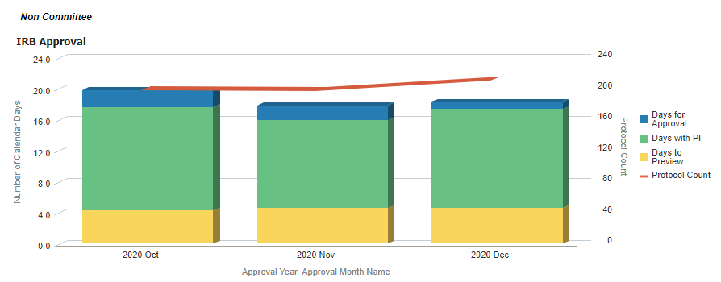
Non-Committee Workload Time Detail Q4 2020

Slide 4
2020 Committee Workload

Slide 5
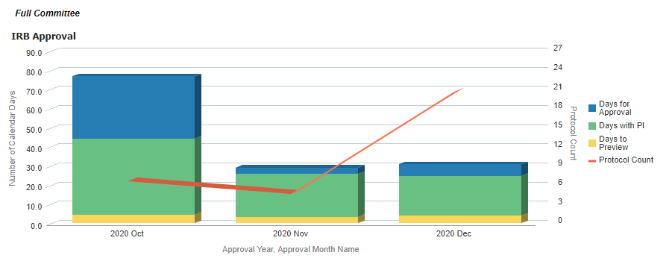
Full Committee Workload Time Detail Q4 2020

Slide 6
IRB Education and Outreach
Consultations: one-on-one meetings between the HSPP staff and researchers.
Presentations: HSPP staff present on IRB topics.
Office Hours: open hours for researchers to bring any IRB related questions to HSPP staff.
In 2020, HSPP spent 298 total hours on education and outreach, nearly double the time spent in 2019 (163 total hours).

Slide 7
Banner Research Sites
Banner sites represent a significant portion of our research efforts.
The most common site used by UA researchers is Banner-Tucson.

Slide 8
Banner Resources
In Quarter 4:
612 projects used biological specimens
1439 projects used the electronic medical record

